Slide 1


GCP - DataFlow
GCP - BigQuery
GCP - VM
CRON
Runner
Servicio
Almacena
Carga
GCP - Storage

Slide 2
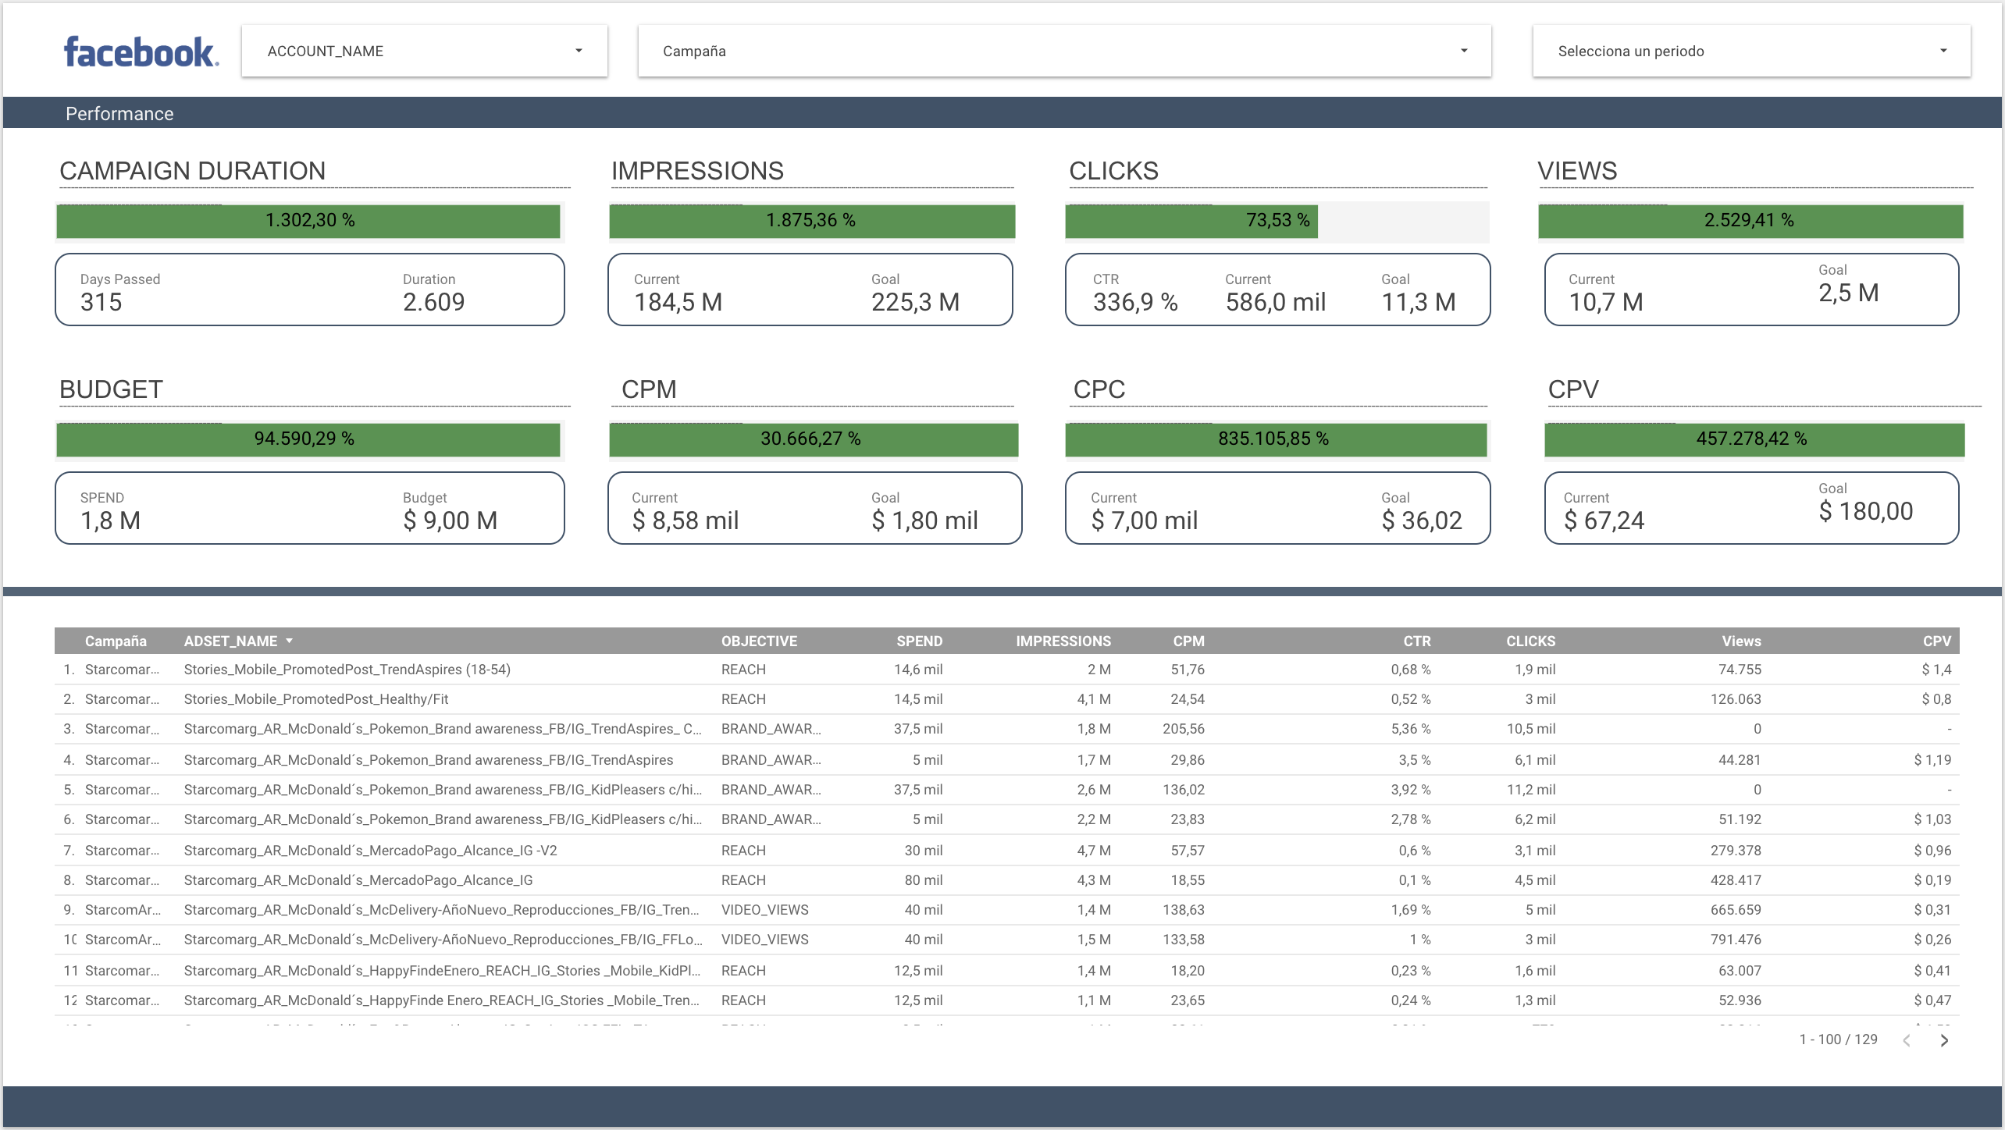
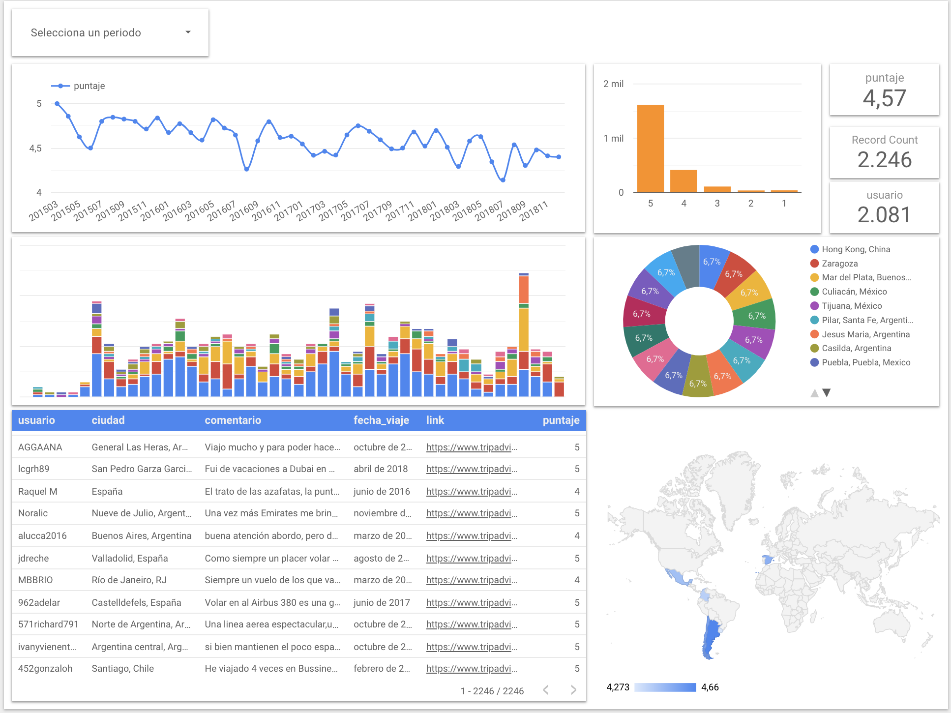

Slide 3
MACHINE LEARNING ON CLOUD
Machine Learning modelling:
Sentiment Analysis
Topic Modelling
Social Network Analysis
Visual Analytics – Image processing
Time Series modelling
Notes:
BUSINESS:

